Slide 1
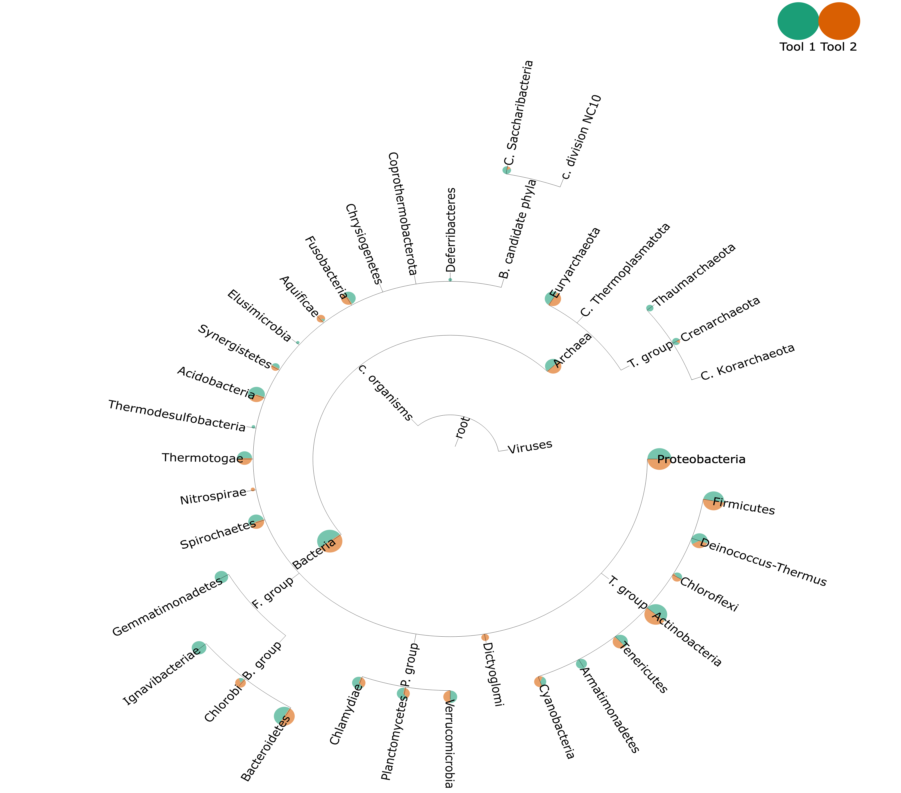
Tools with identical UniFrac scores (phylum)
Tool1: Taxy_pro
Tool2: Metaphyler
UniFrac score: 4

Slide 2
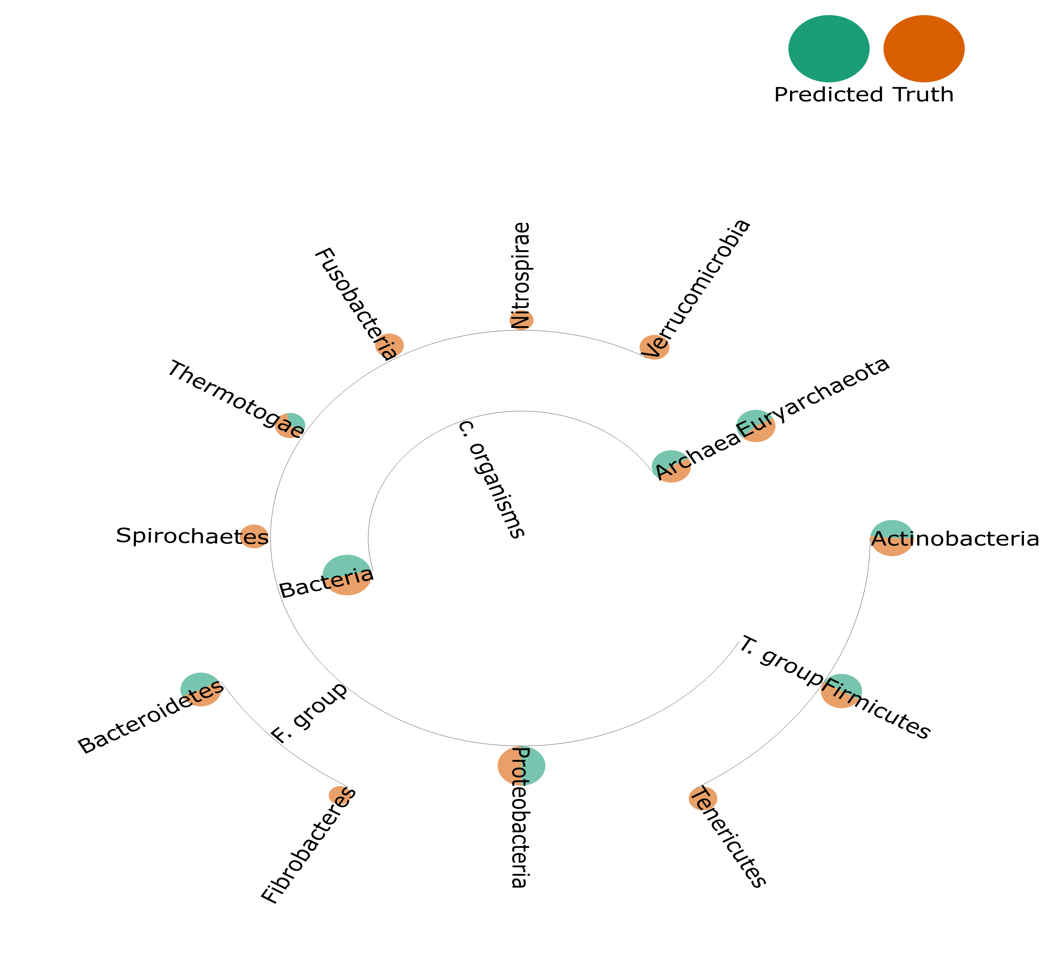
High performance vs ground truth (phylum)
Tool: Metaphyler
L1 Norm: 28

Slide 3
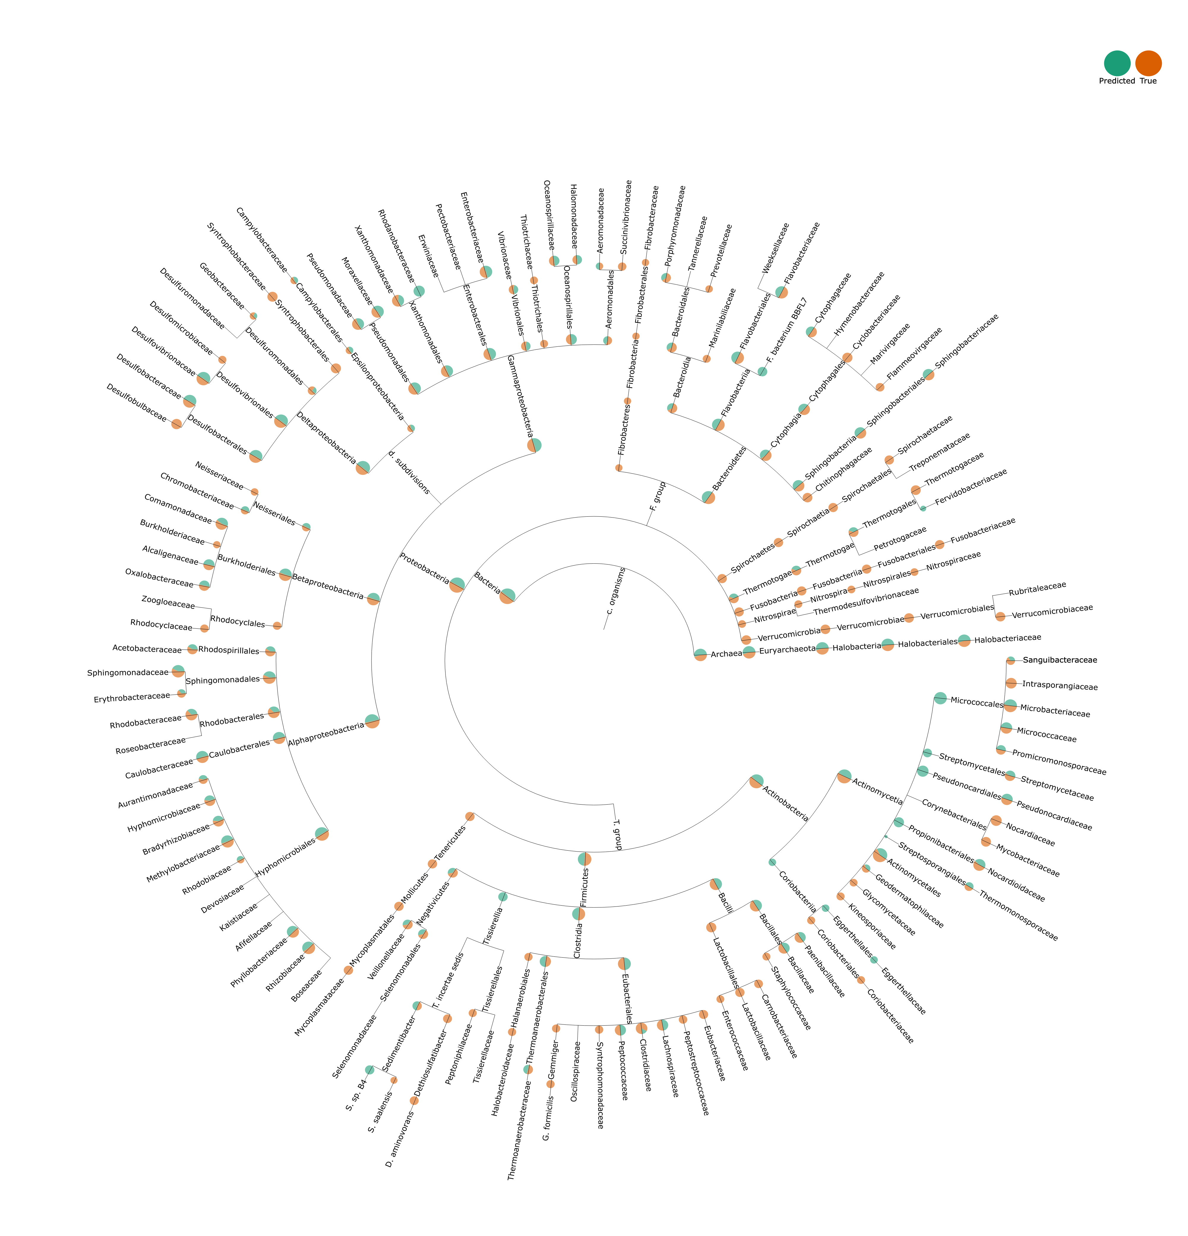
High performance vs ground truth (family)
Tool: Metaphyler
L1 Norm: 42
Precision: 187
Recall: 74

Slide 4
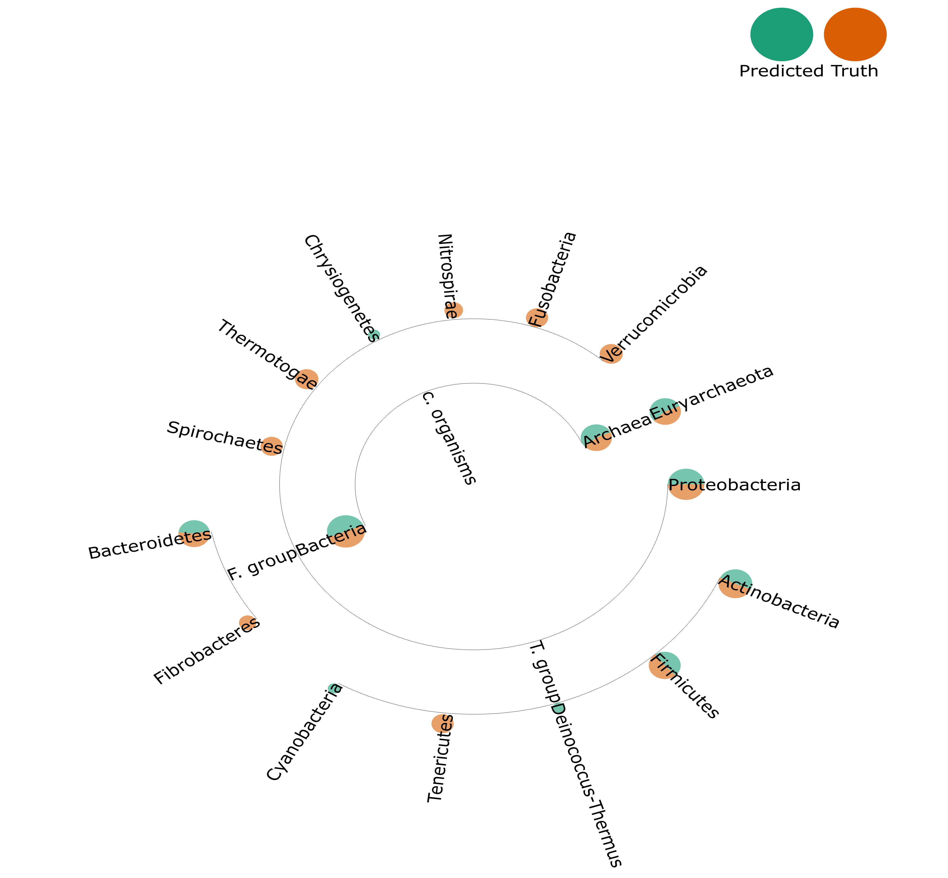
Low performance vs ground truth (phylum)
Tool:mOTU
L1 Norm: 168
Precision: 171
Recall: 148

Slide 5
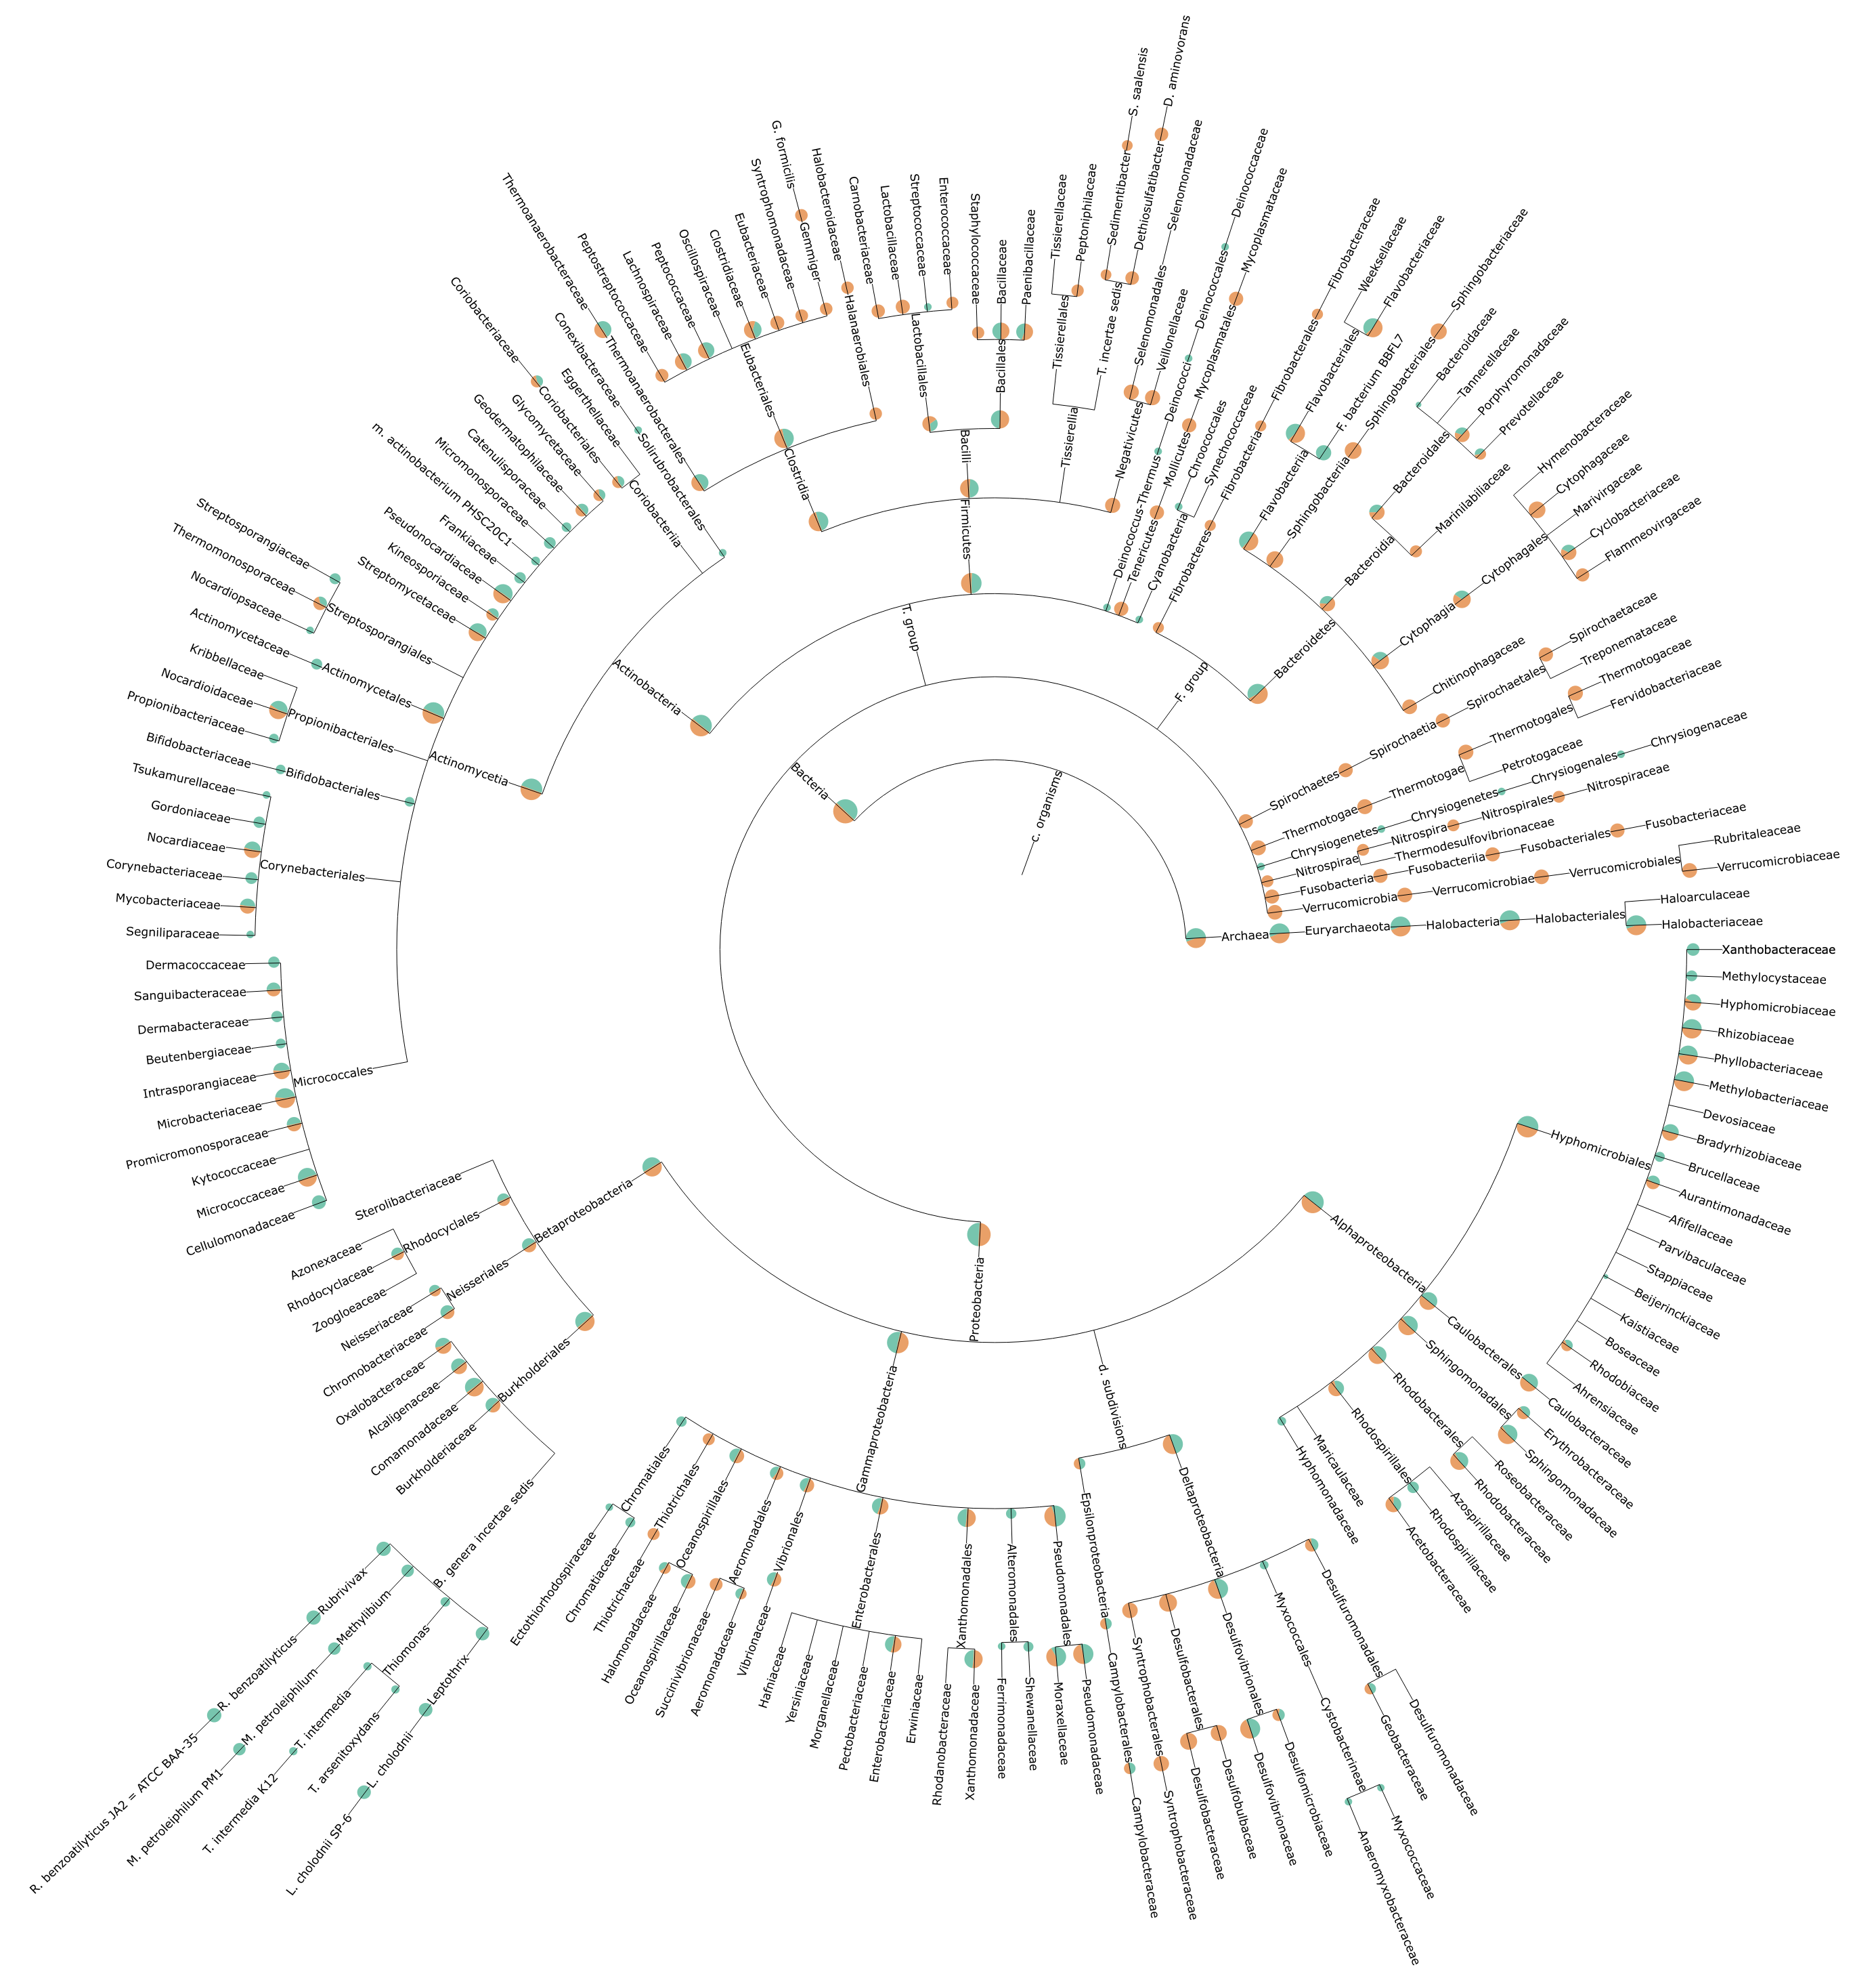
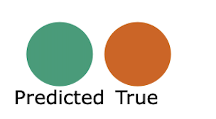
Low performance vs ground truth (family)
Tool:mOTU
L1 Norm: 168
Precision:171
Recall:148

